Slide 1

Search Problems

Slide 2

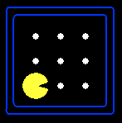





Search Problems
A search problem consists of:
A state space
A successor function
(with actions, costs)
A start state and a goal test
A solution is a sequence of actions (a plan) which transforms the start state to a goal state
“N”, 1.0
“E”, 1.0
Notes:
Often comes back on exams
Goal test – sometimes more than one state that satisfies having achieved the goal, for example, “eat all the dots”
Abstraction

Slide 3

State Space Graphs and Search Trees

Slide 4
State Space Graphs
State space graph: A mathematical representation of a search problem
Nodes are (abstracted) world configurations
Arcs represent successors (action results)
The goal test is a set of goal nodes (maybe only one)
In a state space graph, each state occurs only once!
We can rarely build this full graph in memory (it’s too big), but it’s a useful idea

Slide 5
State Space Graphs
State space graph: A mathematical representation of a search problem
Nodes are (abstracted) world configurations
Arcs represent successors (action results)
The goal test is a set of goal nodes (maybe only one)
In a search graph, each state occurs only once!
We can rarely build this full graph in memory (it’s too big), but it’s a useful idea
a
G
b
c
e
d
f
S
h
p
q
r
Tiny search graph for a tiny search problem

Slide 6
Search Trees
This is now / start
“N”, 1.0
“E”, 1.0
Possible futures
A search tree:
A “what if” tree of plans and their outcomes
The start state is the root node
Children correspond to successors
Nodes show states, but correspond to PLANS that achieve those states
For most problems, we can never actually build the whole tree
Notes:
Different plans that achieve the same state, will be different nodes in the tree.

Slide 7
State Space Graphs vs. Search Trees
State Space Graph
Each NODE in the search tree is an entire PATH in the state space graph.
Search Tree
S
a
G
d
e
p
b
c
q
b
c
e
h
r
d
e
f
a
a
h
r
p
q
f
S
h
We construct both on demand – and we construct as little as possible.
p
q
f
q
c
G
p
q
r
q
c
G
a
a

Slide 8

Quiz: State Space Graphs vs. Search Trees
Consider this 4-state graph:
How big is its search tree (from S)?
a
S
G
b
Important: Lots of repeated structure in the search tree!

Slide 9
Tree Search

Slide 10
Search Example: Romania

Slide 11
General Tree Search
Important ideas:
Fringe
Expansion
Exploration strategy
Main question: which fringe nodes to explore?

Slide 12
Example: Tree Search
a
G
b
c
d
e
f
S
h
p
q
r
Notes:
Left: show tree
Right: fringe

Slide 13
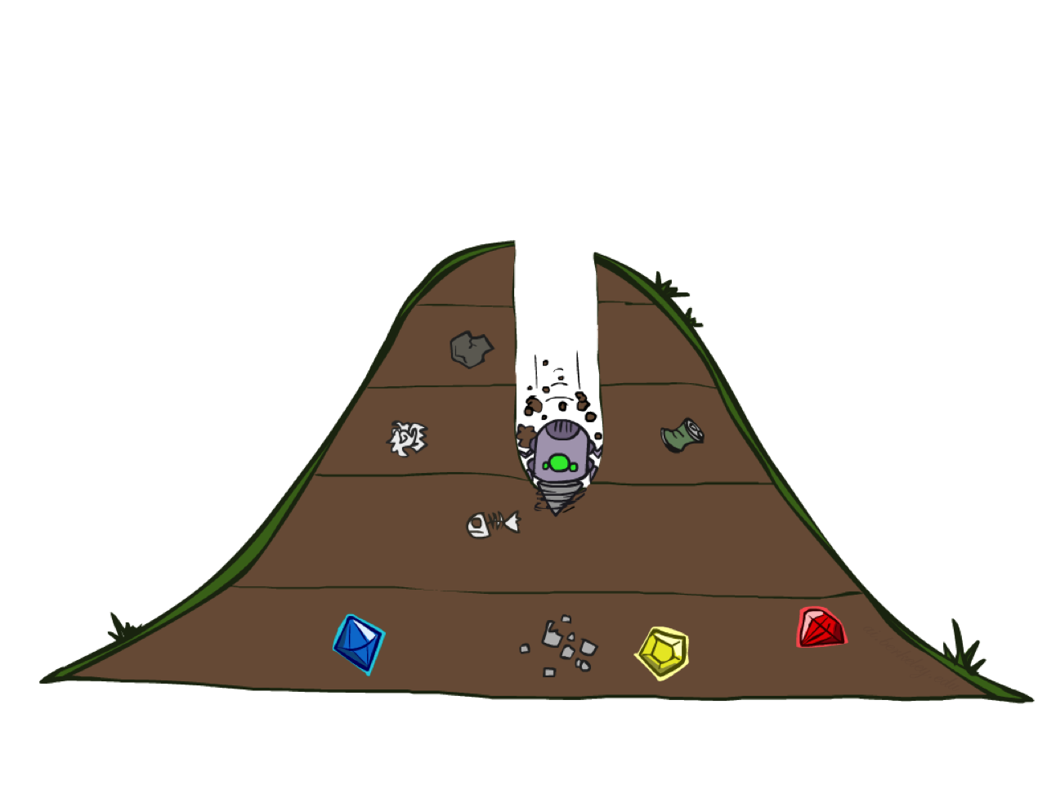
Depth-First Search

Slide 14
Depth-First Search
Strategy: expand a deepest node first
Implementation: Fringe is a LIFO stack
a
G
a
c
b
c
b
e
d
e
d
f
f
S
h
h
p
p
r
q
r
q
S
d
e
p
b
c
e
h
r
q
a
a
h
r
p
q
f
p
q
f
q
c
G
q
c
G
a
a

Slide 15
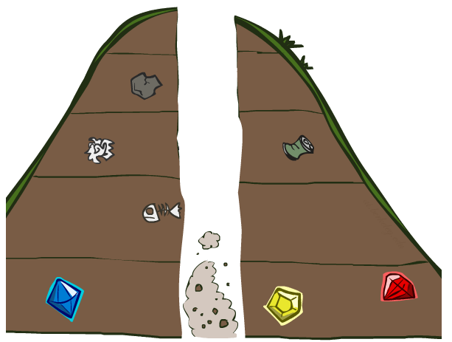
Search Algorithm Properties

Slide 16
Search Algorithm Properties
Complete: Guaranteed to find a solution if one exists?
Optimal: Guaranteed to find the least cost path?
Time complexity?
Space complexity?
Cartoon of search tree:
b is the branching factor
m is the maximum depth
solutions at various depths
Number of nodes in entire tree?
1 + b + b² + …. b^{m} = O(b^{m})
1 node
b
…
b nodes
b² nodes
m tiers
b^{m} nodes

Slide 17
Depth-First Search (DFS) Properties
What nodes DFS expand?
Some left prefix of the tree.
Could process the whole tree!
If m is finite, takes time O(b^{m})
How much space does the fringe take?
Only has siblings on path to root, so O(bm)
Is it complete?
m could be infinite, so only if we prevent cycles (more later)
Is it optimal?
No, it finds the “leftmost” solution, regardless of depth or cost
1 node
b
…
b nodes
b² nodes
m tiers
b^{m} nodes

Slide 18
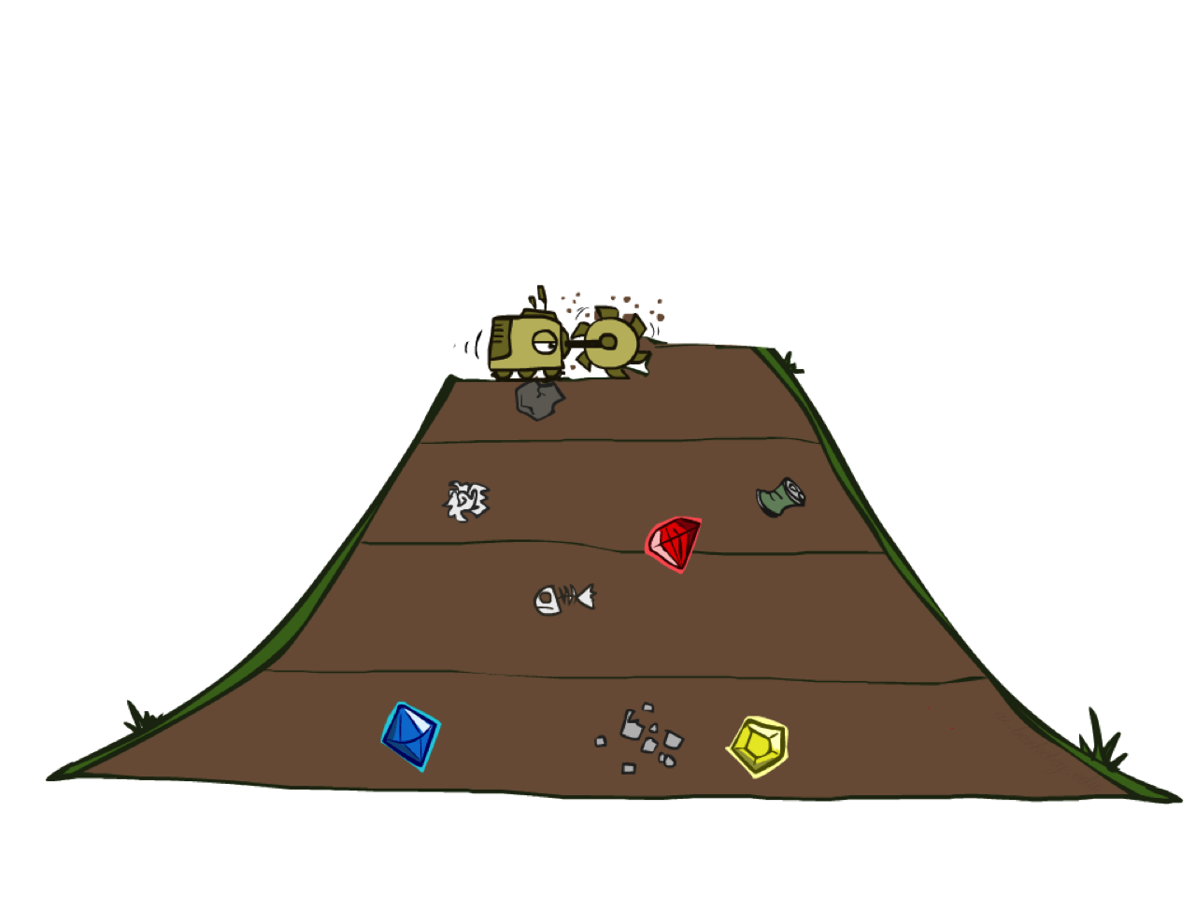
Breadth-First Search

Slide 19
Breadth-First Search
Strategy: expand a shallowest node first
Implementation: Fringe is a FIFO queue
a
G
b
c
d
e
f
S
h
p
q
r
S
d
e
p
Search
Tiers
b
c
e
h
r
q
a
a
h
r
p
q
f
p
q
f
q
c
G
q
c
G
a
a

Slide 20
Breadth-First Search (BFS) Properties
What nodes does BFS expand?
Processes all nodes above shallowest solution
Let depth of shallowest solution be s
Search takes time O(b^{s})
How much space does the fringe take?
Has roughly the last tier, so O(b^{s})
Is it complete?
s must be finite if a solution exists, so yes!
Is it optimal?
Only if costs are all 1 (more on costs later)
1 node
b
…
b nodes
s tiers
b² nodes
b^{s} nodes
b^{m} nodes

Slide 21
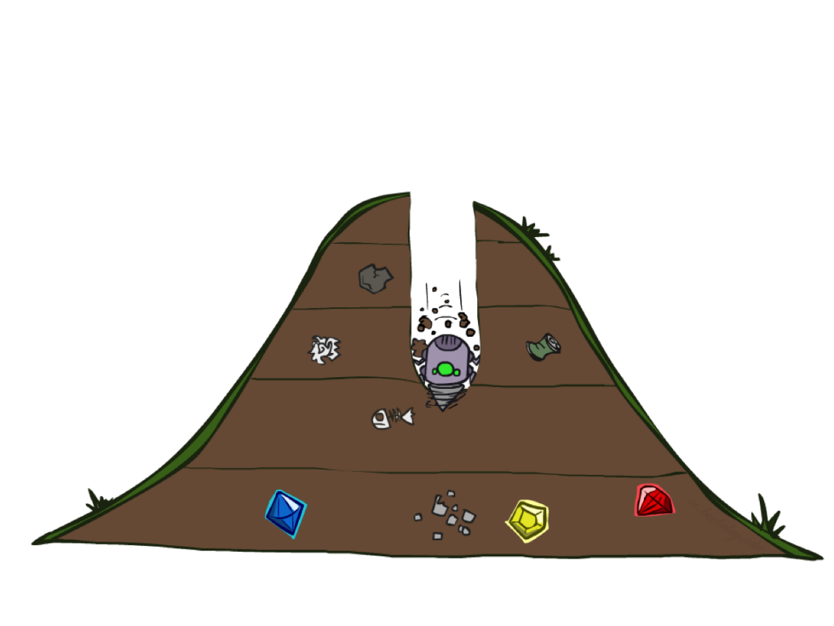
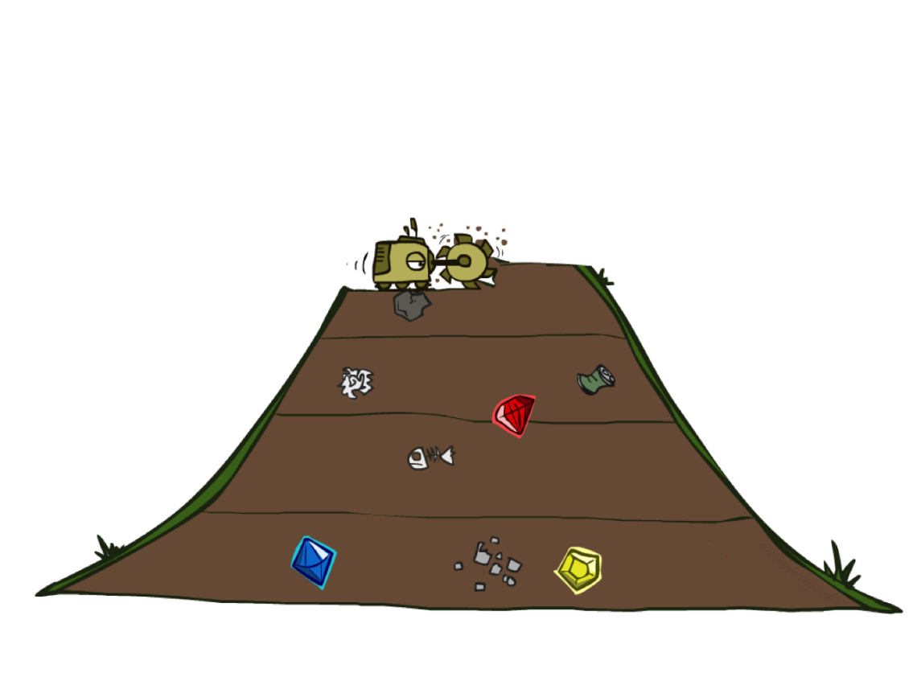
Quiz: DFS vs BFS

Slide 22
Quiz: DFS vs BFS
When will BFS outperform DFS?
When will DFS outperform BFS?
[Demo: dfs/bfs maze water (L2D6)]

Slide 23
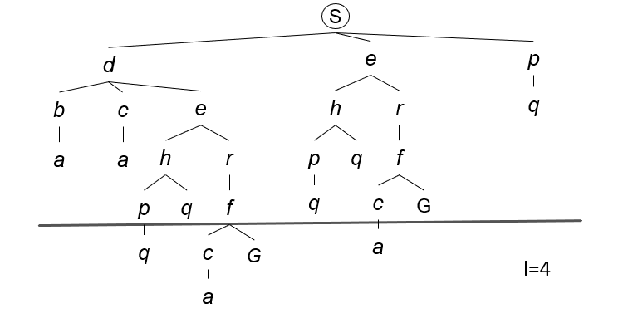
Depth Limited Search (DLS)
Strategy: use DFS with a depth limit
a
G
b
c
d
e
f
S
h
p
q
r

Slide 24
Depth Limited Search (DLS) Properties
Complete: Guaranteed to find a solution if one exists?
Optimal: Guaranteed to find the least cost path?
Time complexity?
Space complexity?

Slide 25
Iterative Deepening (IDDFS)
Idea: get DFS’s space advantage with BFS’s time / shallow-solution advantages
Run a DFS with depth limit 1. If no solution…
Run a DFS with depth limit 2. If no solution…
Run a DFS with depth limit 3. …..
Isn’t that wastefully redundant?
Generally most work happens in the lowest level searched, so not so bad!
Preferred for problems where the depth of the solution is unknown but the search space might be very large or even infinite
b
…

Slide 26
Cost-Sensitive Search
a
GOAL
2
2
b
c
3
2
1
8
2
e
d
f
3
9
8
2
START
h
1
4
2
p
4
r
15
q
BFS finds the shortest path in terms of number of actions.
It does not find the least-cost path. We will now cover
a similar algorithm which does find the least-cost path.

Slide 27
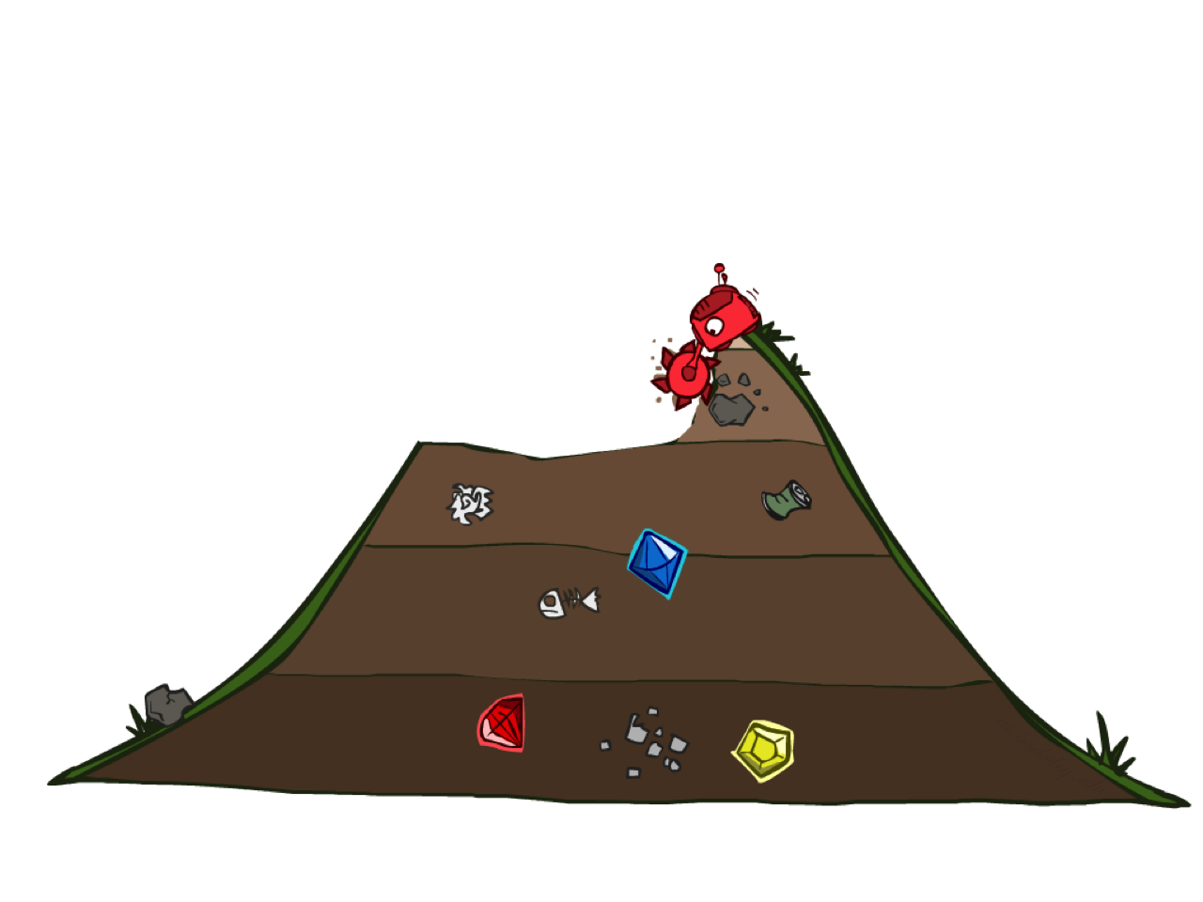
Uniform Cost Search

Slide 28
Uniform Cost Search
2
G
a
Strategy: expand a cheapest node first:
Fringe is a priority queue (priority: cumulative cost)
b
c
1
8
2
2
e
3
d
f
9
8
2
S
h
1
1
p
q
r
15
0
S
d
3
e
9
p
1
b
4
e
5
h
17
r
11
q
16
c
11
Cost contours
a
6
a
h
13
r
7
p
q
f
f
8
q
c
G
c
a
11
G
10

Slide 29
Uniform Cost Search (UCS) Properties
What nodes does UCS expand?
Processes all nodes with cost less than cheapest solution!
If that solution costs C* and arcs cost at least ε , then the “effective depth” is roughly C*/ε
Takes time O(b^{C*/ε}) (exponential in effective depth)
How much space does the fringe take?
Has roughly the last tier, so O(b^{C*/ε})
Is it complete?
Assuming best solution has a finite cost and minimum arc cost is positive, yes!
Is it optimal?
Yes! (Proof next lecture via A*)
b
c ≤ 1
…
C*/ε “tiers”
c ≤ 2
c ≤ 3

Slide 30
Uniform Cost Issues
Remember: UCS explores increasing cost
The good: UCS is complete and optimal!
The bad:
Explores options in every “direction”
No information about goal location
We’ll fix that soon!
…
c ≤ 1
c ≤ 2
c ≤ 3
Start
Goal

Slide 31

The One Queue
All these search algorithms are the same except for fringe strategies
Conceptually, all fringes are priority queues (i.e. collections of nodes with attached priorities)
Practically, for DFS and BFS, you can avoid the log(n) overhead from an actual priority queue, by using stacks and queues
Can even code one implementation that takes a variable queuing object

Slide 32
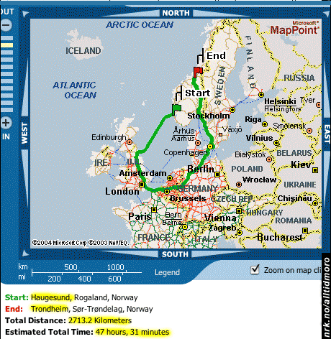
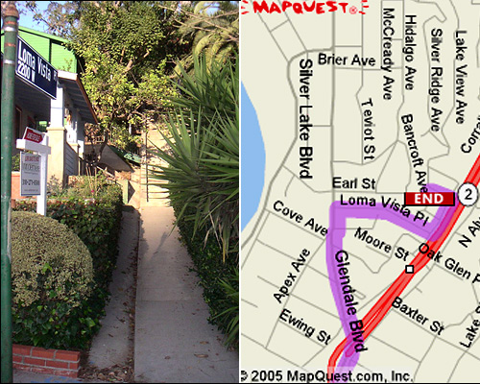

Search Gone Wrong?

